Slide 1

A Review of State Data Centers Indicators, Tools, and Methods
Treena Goswami, UVA
Marijke van der Geer and Jianing Cai,
UVA Data Science for the Public Good students
Neil Kattampalil, UVA
Vicki Lancaster, UVA
Stephanie Shipp, UVA
Emily Molfino, US Census Bureau
Applied Demography Conference
February 7, 2024

Slide 2
Project Goals
To provide the Census Bureau with information on the State Data Centers (SDC)
What data sources, tools and statistical products they use?
How do they use these data sources?
What are standard practices among the SDC network?
In this project: Examined SDCs, in the 50 states, the District of Columbia, and Guam and Puerto Rico territories.
Notes:
This report examines SDCs, in the 50 states, the District of Columbia, and Guam and Puerto Rico territories.
The overall objective of this project is to gain insight into how entities harness the power of data and report findings on how data users leverage their data, the tools they use, and the deliverables they produce, so that the Census Bureau can use our findings to better address state government data needs and to create a tool that facilitates user data access
To accomplish this, we’ve focused on identifying how state-level Census partners use data and identifying what those data sources are, such as Census, state government, or private sources. We did this through our data discovery process in which we collected data from state constitutions, State Data Centers, and the Federal-State Cooperative for Population Estimates contacts.

Slide 3
What are State Data Centers (SDC)?
Provide accessible, accurate, and timely information to data users
Partner with the U.S. Census Bureau
Facilitate connections across their network of local groups, individuals, and the Census Bureau’s statistical products
Notes:
SDCs play a role in providing accessible, accurate, and timely information to data users
Have mutually beneficial partnership with the U.S. Census Bureau.
Acting as an intermediary, the SDC network facilitates connections between local groups, individuals, and the Census Bureau’s statistical products.

Slide 4
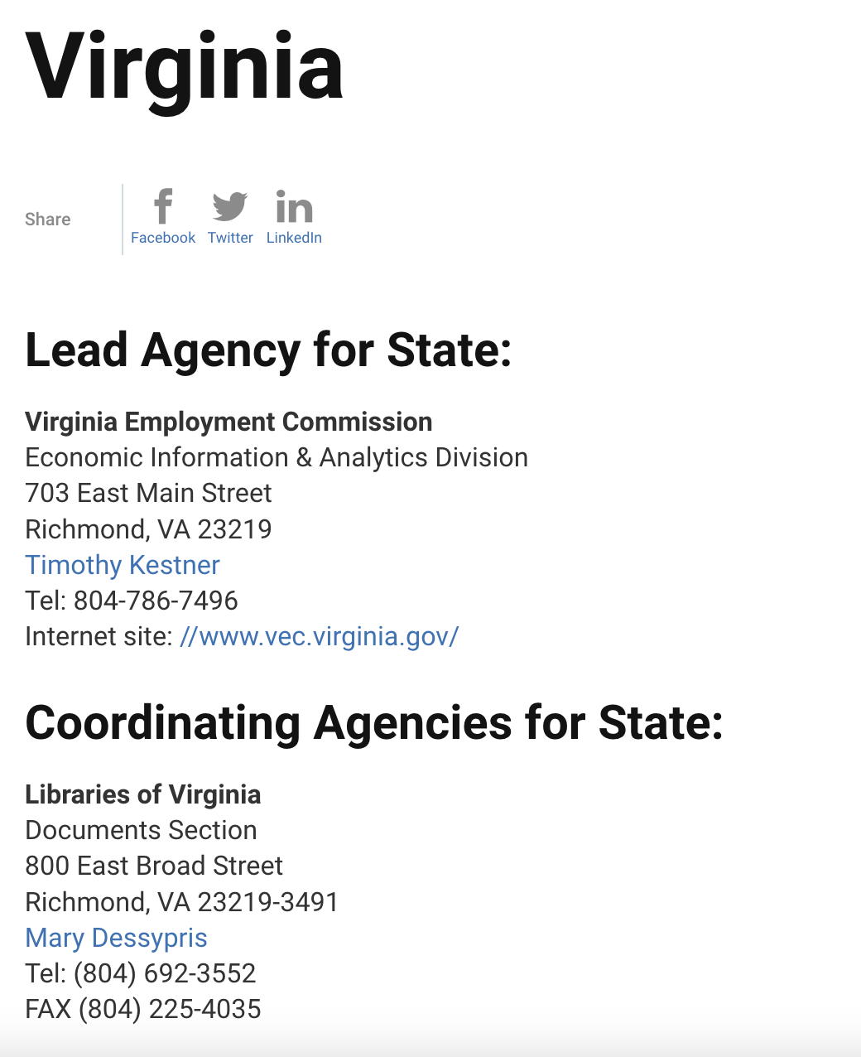

State Data Centers
Lead and have one or more coordinating agencies
  Some states do not have coordinating agencies, ex: Colorado
Numerous types of lead agencies
  Universities, Libraries, Research Centers
Notes:
Each state designates one lead SDC agency, often affiliated with diverse organizations such as universities, libraries, and research centers.
Additionally, states may have multiple coordinating agencies contributing to the collaborative effort.
The coordinating agencies that provide data support to users, supplementing the SDCs, and the lead agencies coordinate this statewide network.
This collaborative network partners with the Census Bureau, through the Data Users Branch (DUB) and the Census Bureau's Regional Offices, to facilitate and meet data needs and dissemination at the local level (U.S. Census Bureau).
Example of the state of Virginia on the right

Slide 5
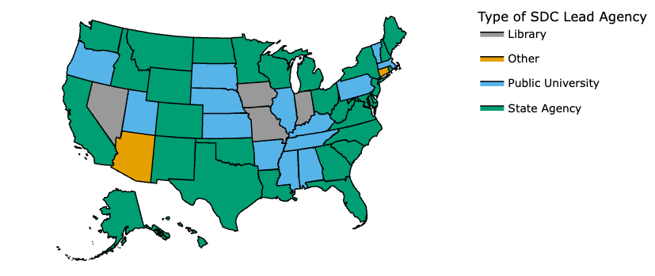
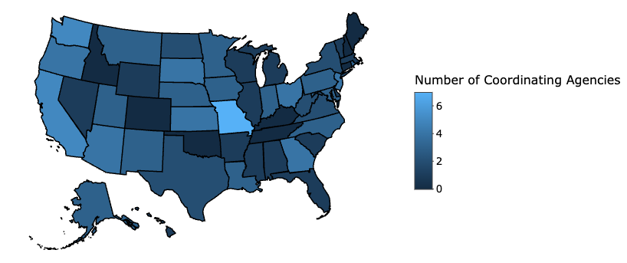
State Data Center (SDC) Member Network:
Lead and Coordinating Agencies
Type of SDC Lead by State, 2023
Number of Coordinating Agencies by State, 2023
Notes:
LEAD AGENCY
Below is a visualization of the type of lead agency for each state.
These agencies are from numerous types of organizations: Libraries, State Agencies, Universities (Public and Private), and Others. All the universities hosting lead agencies are public.
CT SDC is nonprofit. Arizona has “Economic Development Organization” and Puerto Rico has “Autonomous Public Entity”.
Coordinating agencies also located within universities, and not all of them are public. For instance, in the case of the New York State Data Center (SDC), one of its coordinating agencies is the Cornell Program on Applied Demographics, which is part of Cornell University. See Exhibit 1.
31 State Agency-led SDCs, e.g., Virginia’s SDC is led by the Virginia Economic Commission; New Hampshire Office of Planning and Development.
4 Library-led SDCs, e.g., Nevada State Library and Archives; Missouri State Library.
14 Public University-led SDCs, e.g., University of Vermont’s Center for Rural Studies; University of Mississippi’s Center for Population Studies.
2 Other type SDCs, Arizona Commerce Authority (ACA) is an economic development organization; Connecticut’s CT Data Collaborative is a nonprofit organization.
COORDINATING AGENCY
The number of coordinating agencies ranges from 0 in 10 states to 7 in 1 state, Missouri. See Exhibit 2.

Slide 6
Our Methods:
Text analysis of state constitutions and amendments
Text analysis of SDC mission statements
Review of SDC websites
Survey of the Federal-State Cooperative for Population Estimates (FSCPE) contacts; and
Exploration of search platforms and databases

Slide 7
Method 1: Text analysis of state constitutions and amendments
Findings
  These documents encompass broad topics
  Topics and words are interesting BUT do not say what data a state requires, uses, or needs
Methods
  Manual Search and Topic Modelling (GENSIM and BERT)
Notes:
Documents predominantly encompass broad topics. While these topics and words are interesting to explore, they do not tell us what data a state requires, uses, or needs. Consequently, we turned our attention to SDC websites.
MANUAL SEARCH
Collected constitutions and amendments
Converted .pdf to .txt files
Searched 2 constitutions each for key words
Data, census, information, etc.
Looked for adjectives that could be "tested" by data
Minimum, maximum, annual, etc.
COMPUTER SEARCH
In statistics and natural language processing, a topic model is a type of statistical model for discovering the abstract "topics" that occur in a collection of documents.
A frequently used text-mining tool for discovery of hidden semantic structures in a text body.
Packages: GENSIM, BERT
"Gensim" stands for "Generate Similar,"
BERT stands for "Bidirectional Encoder Representations from Transformers."

Slide 8
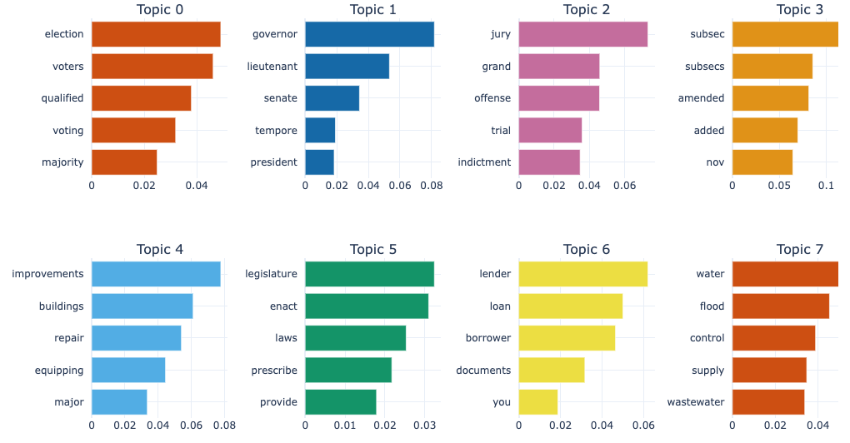
Topic Modeling using BERT
Method 1: Text analysis of state constitutions and amendments
Example: Eight most frequent topics in the state constitution and amendments of Texas
Notes:
Eight most frequented topics found within Texas's state constitution and amendments, each accompanied by a set of words and their associated probabilities.
These words underline the core themes of each topic.
For example, Topic 0, the most frequently occurring topic, encompasses words like 'election,' 'voters,' and 'qualified,' collectively pointing to its relevance to electoral processes. Likewise, Topic 1 revolves around terms associated with positions of authority, including 'governor' and 'lieutenant,' providing insights related to governmental leadership.
Approach 1 Summary
State Constitutions contain only broad topics
Narrow down our focus to State Data Centers

Slide 9
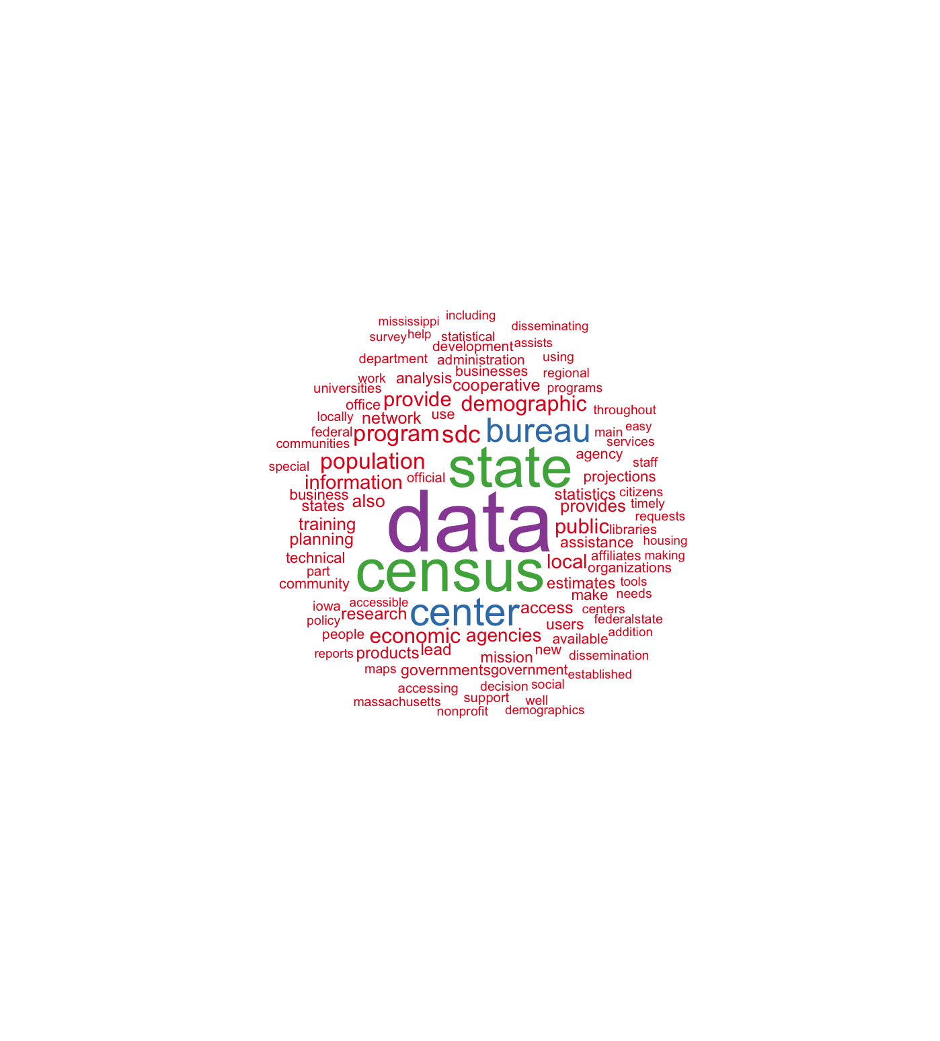
Method 2: Text analysis of SDC mission statements
Word Cloud for 38 SDC mission statements
-demographics
-community
-housing
-regional
-population
-economic agencies
Notes:
Collection of SDC mission statements
Word-clouds
Individual (Maryland) vs. Combination

Slide 10
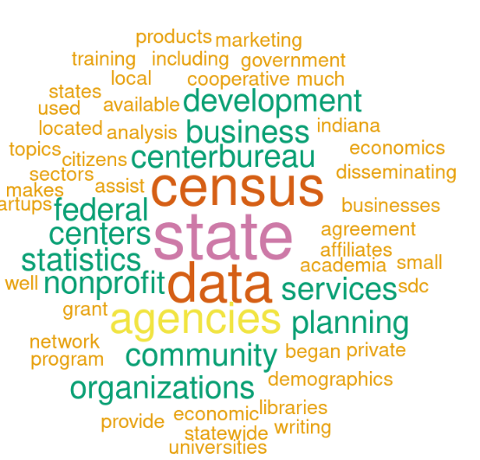
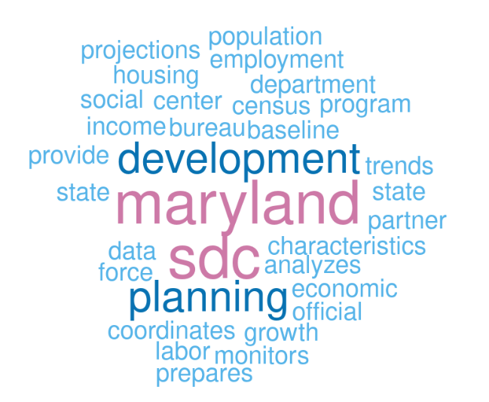
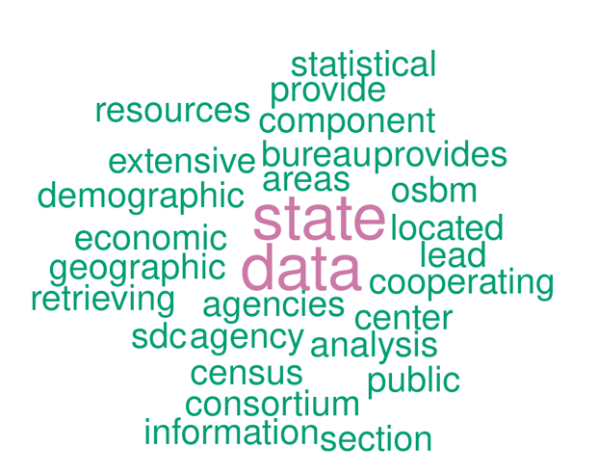
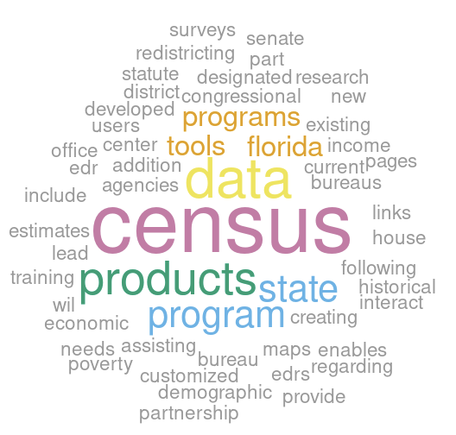
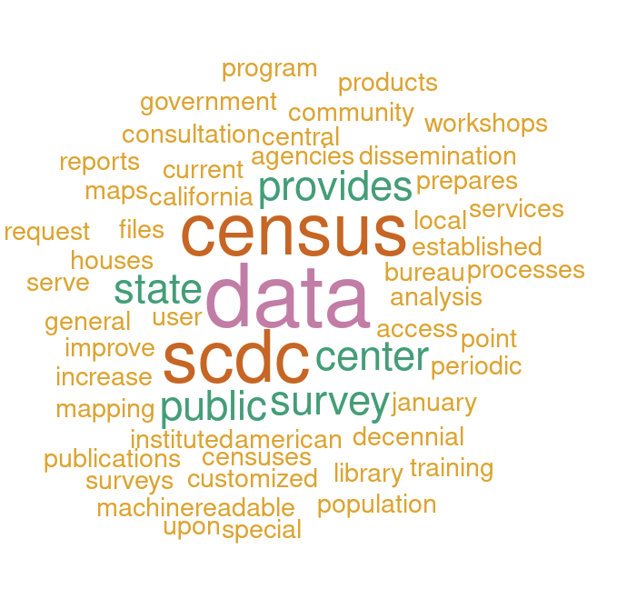
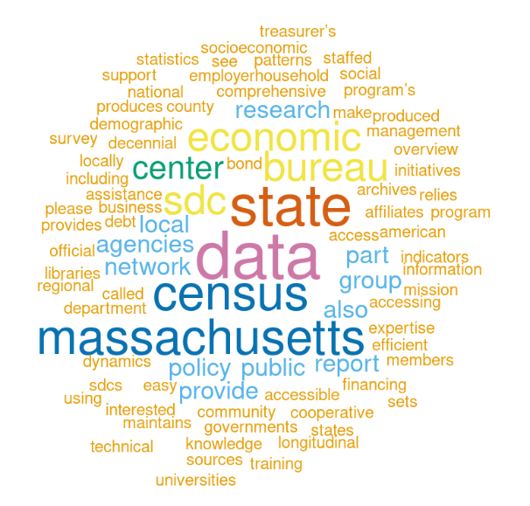
Word clouds derived from State Data Center Missions Statements:
Indiana, Maryland, North Carolina, Florida, California, and Massachusetts
Method 2: Text analysis of SDC mission statements
Indiana
Maryland
North Carolina
Florida
California
Massachusetts
Notes:
The slide presents word clouds summarizing the SDC’s Mission Statements from six states: Indiana, Maryland, North Carolina, Florida, California, and Massachusetts. These six SDC Mission Statements were chosen because they showed a variety of activities and data services provided. The primary and secondary words reflect the similarity and variation of interests for each SDC, for example:
Indiana – development, business, nonprofits, services, planning, community, organizations
Maryland – development, planning, trends, growth, income, housing, projections
North Carolina – resources, economics, demographic, geographic, analysis, international
Florida – programs, tools, products, maps, redistricting, training, poverty
California – center, public, survey, training, workshops, reports, maps, consultation
Massachusetts – economic, census, research, public policy, networks, local agencies

Slide 11
Method 3: Review of the SDC websites
Classified all SDC data tools and data sources into six broad categories
Categories | Sub-categories | Sources examples
Demographics | Estimates, Projections – Total and by demographics such as age, gender, race | U.S. Census Bureau
Economy | Economy, Employment, Income, Job, Labor force, Tax, Wage | Bureau of Economic Analysis, Bureau of Labor Statistics, U.S. Department of Labor
Housing | Residential Mobility, Projections, Permits, Occupancy, Housing Units, Housing Prices/Rents, Housing Characteristics, Household Size, Household Type, Household Income, Foreclosures | U.S. Department of Housing and Urban Development
Health | SNAP, Physicians, Mental Health, Medicaid, Insurance, Incidence Rates, Health Estimates, Health Counts, Health Characteristics, Healthcare, Disability, Births and Deaths | Centers for Disease Control and Prevention, National Center for Health Statistics Centers for Medicare & Medicaid Services, State Health Departments
Education | Student Poverty, Student Performance, School Enrollment, School District, School Attendance, Public School, Post-Secondary, Graduation Rates, Educational Attainment, Education Services, Education Estimates, Education Counts, Education Characteristics, Adult Education | National Center for Education Statistics, State Education Departments
Diversity | Race and Ethnicity combined | U.S. Census Bureau
Notes:
Every SDC website was organized to meet the needs of the state and reflected the amount of resources that SDC received.
Due to the varied organizational structures of the SDCs, we opted against employing web scraping for a systematic SDC review and instead conducted a manual audit. The primary drawback of the manual search lies in the substantial time investment.
The SDCs disseminate diverse information across various geographic levels.
Based on an in-depth examination of the SDC websites, we organized the findings into six broad categories to enhance accessibility and understanding.
These categories include demographics, economy, housing, health, education, and diversity.
These classifications are based on our initial scan of the data.
Within each broad category, we observe subcategories that reflect the specific topic on the data provided.
Exhibit above outlines these six main categories along with their respective subcategories.
For the specific category of diversity, defined in the context of population estimates and projections, if available, is based on race and ethnicity combined. But we looked at it as separate category from population.
Several subcategories, despite possibly measuring the same aspects, are labeled differently by different states. These differences exemplify the variation in terminology used by states when disseminating comparable data.
For the states that present data on diversity, the total number of race and ethnicity categories usually aligned closely with the Office of Management and Budget (OMB) standards. However, some states, such as Alabama, offered limited data, classifying populations broadly into white and non-white. In contrast, some states, such as California, Iowa, and Kansas, provided detailed information, including the enumeration of Native American tribes, resulting in an extensive listing.
The exploration of the SDC data landscape highlights the variety of information provided by SDCs, presenting the details of state-level demographics, economic landscapes, housing dynamics, health indicators, educational trends, and diversity metrics. The variations in data presentation underscore the uniqueness of each state's approach, highlighting the importance of understanding local areas for informed decision-making and policy formulation. Certain state SDCs, such as Delaware, Georgia, Hawaii, Louisiana, Mississippi, New Mexico, redirect data inquiries related to population projections and estimates to the U.S. Census Bureau website.

Slide 12
Key Findings
Method 3: Review of the SDC websites ​
Variation in the information provided by SDCs
For the diversity data reporting, total number of race and ethnicity categories usually aligned with the Office of Management and Budget (OMB) standards. There are exceptions: Limited data in Alabama & Detailed information in California, Iowa, Kansas
Certain state SDCs redirect data inquiries to the U.S. Census Bureau website, such as population projections and estimates in Delaware, Georgia, Hawaii, Louisiana, Mississippi, New Mexico
Challenges in locating data for specific categories in certain states
Most prevalent methods of data dissemination are display tables and table downloads
Lack of data citation
  Attribute data to the U.S. Census Bureau without specifying the Census Bureau product or survey
Notes:
The exploration of the SDC data landscape highlights the variety of information provided by SDCs, presenting the details of state-level demographics, economic landscapes, housing dynamics, health indicators, educational trends, and diversity metrics. The variations in data presentation underscore the uniqueness of each state's approach, highlighting the importance of understanding local areas for informed decision-making and policy formulation.
For the states that present data on diversity, the total number of race and ethnicity categories usually aligned closely with the Office of Management and Budget (OMB) standards.
However, some states, such as Alabama, offered limited data, classifying populations broadly into white and non-white. In contrast, some states, such as California, Iowa, and Kansas, provided detailed information, including the enumeration of Native American tribes, resulting in an extensive listing.
Certain state SDCs, such as Delaware, Georgia, Hawaii, Louisiana, Mississippi, New Mexico, redirect data inquiries related to population projections and estimates to the U.S. Census Bureau website.
Encountered challenges in locating data for specific categories in certain states.
Some of these omissions are attributable to the absence of data in specific categories, whether in the lead SDC or coordinating agencies.
Health and education data were not found in the SDCs for Louisiana, Idaho, and Delaware.
Housing data was not on the SDC websites for Michigan, Minnesota, and Idaho.
SDCs for the District of Columbia and Louisiana lacked economy-related information.
Display tables and table downloads are the most prevalent methods of data dissemination.
The majority of SDCs also disseminate data through visualization, infographics, maps, reports, display tables, and download options across various categories.
Some SDCs, such as Alaska, the District of Columbia, and Iowa, as well as other states, create a variety of maps and infographics for housing, health, and education categories.
SDC Data Sources but lack of citation
The primary source of SDC information is the U.S. Census Bureau, which has commonly referenced statistical products and surveys such as the American Community Survey (ACS) and the Decennial Census.
Many SDCs also have data from other federal agencies such as the Bureau of Economic Analysis, the Bureau of Labor Statistics, the U.S. Department of Housing and Urban Development, the U.S. Department of Labor, the Centers for Disease Control and Prevention, and the National Center for Health Statistics. SDCs also have data from nonfederal entities, including state and local agencies that focus on the economy, education, health, housing, and labor.

Slide 13
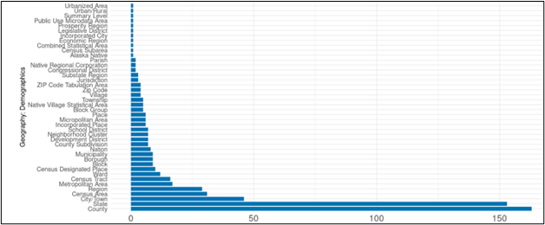
Summary of Different Geographies for 28 States and Territories
Method 3: Review of the SDC websites
Top 5 are:
  1. County
  2. State
  3. City/Town
  4. Census Areas
  5. Region
Notes:
Level of Geographies
SDCs also present data by varying geographic levels. The most utilized geographic levels across the six broad data categories are state and county.
This aligns with the fact that the Census Bureau disseminates most of its data at the state and county level, and the Census Bureau is the primary source of information for the SDCs.
Geographic terminology at the local level is more diverse, reflecting administrative structures and traditions, such as state or region-specific nomenclatures like 'parishes' in Louisiana, 'towns' in Connecticut, or 'neighborhood clusters' in the District of Columbia. Notably, custom geographies emerge for administrative purposes. One example is groupings of counties related to development of groups of counties, such as 'economic development regions' in Kansas and 'development districts' in Kentucky.
Furthermore, when delving into demographic or diversity data, states with significant American Indian or Alaska Native populations, like Alaska, provide data for 'Native Village Statistical Areas' and 'Native Regional Corporations.' This underscores the importance of recognizing and accommodating region-specific terminologies and structures when interpreting data from SDCs. When it comes to educational data, school districts emerge as a frequently utilized geographic level.

Slide 14
SDC Early Adopters
Exhibit forward-thinking practices within the SDC network
Method 3: Review of the SDC websites
Colorado SDC Publishes population estimates and projections by combining data from various Census and non-Census sources | New Mexico SDC Provides up-to-date information on the workforce profile and economic characteristics Releases regular updates, as recent as November 2023, offer timely and relevant economic data.
Kansas SDC Offers overview of regional and county characteristics for diverse categories through the Kansas Regional Data Portal User-friendly platform engages users with interactive data presentation Provides citations for the data, enhancing transparency and credibility. | New York SDC Detailed dashboard with variables from the American Community Survey and Current Population Survey Provides a Self-Sufficiency Earnings Estimator that calculates the income required for basic needs, considering family size and geographic location
Notes:
SDCs that exhibit forward-thinking practices within the SDC network referred to as early adopters. These SDCs proactively leverage Census Bureau data while supplementing it with information from state agencies and other federal agencies. These SDCs stand out for their strategic use of multiple data sources, to create statistical products. This proactive approach enables them to release data that addresses the evolving needs of users.
Four SDCs stand out as forward-thinking entities, each distinguished by unique approaches in addressing user data needs: Colorado, Kansas, New Mexico, and New York.
Four early adopter states were identified for the breadth and depth of their data offerings: Colorado, New Mexico, Kansas, and New York.
The Colorado State Data Center (SDC) publishes population estimates and projections by combining data from various sources, including Census Bureau data such as the American Community Survey and Decennial Census, along with non-Census data from entities like the Colorado Department of Public Health and Environment, Internal Revenue Service, Medicare, and Immigration Statistics.
The Kansas SDC, with its Kansas Regional Data Portal, a dynamic dashboard, offers an overview of regional and county characteristics. Covering diverse categories such as demographics, housing, business, healthcare, quality of life, infrastructure, and natural resources, this user-friendly platform engages users with interactive data presentation. Notably, the portal provides citations for the data, enhancing transparency and credibility.
Situated in the New Mexico Economic Development Department, the New Mexico SDC strategically focuses on economic characteristics. While redirecting population, social, and housing data to Census Bureau products, it excels in providing up-to-date information on the workforce profile. Regular updates, as recent as November 2023, offer timely and relevant economic data.
The New York SDC stands out for its detailed dashboard, encompassing variables from the American Community Survey and Current Population Survey for the state and counties. Beyond conventional data offerings, it provides a Self-Sufficiency Earnings Estimator. This tool, originally developed by the Center for Women’s Welfare, University of Washington, calculates the income required for basic needs, considering family size and geographic location. The inclusion of regional occupational information adds a valuable dimension, aiding users in making informed career decisions.
In summary, these forward-thinking SDCs display a diverse range of strategies, from comprehensive data integration to interactive dashboards and specialized tools. Their initiatives not only address immediate data needs but also pave the way for potential replication and adoption by other SDCs nationwide, contributing to informed users .

Slide 15
Method 4: Survey of the Federal-State Cooperative for Population Estimates (FSCPE) contacts
What are FSCPE agencies?
  State FSCPE agencies work in cooperation with the Census Bureau's Program Branches to produce population estimates, consistent with the last decennial census counts
Summary of 18 FSCPE responses
  Rely on data.census.gov for comprehensive Census data
  For historical data – use National Historical Geographic Information System (NHGIS)
  Economic indicators – Bureau of Economic Analysis (BEA), St. Louis Federal Reserve Economic Data (FRED)
  States employ proprietary tools and dashboards, example: California Department of Finance and the DC Office of Planning
Method:
  Conducted three rounds of outreach to the 56 FSCPE members, resulting in responses from 18 states
Notes:
State FSCPE agencies, designated by their respective governors, work in cooperation with the Census Bureau's Program Branches to produce population estimates, consistent with the last decennial census counts.
The Census Bureau begins the process of preparing population estimates by updating population information from the most recent census with information found in the annual administrative records of Federal and state agencies. The Census estimates are sent to the FSCPE agencies for review and comment. Population estimates are used to distribute Federal dollars and to determine eligibility for many social programs which are based on population.
The FSCPE responses to the survey include a diverse range of data sources utilized by different states and territories in the United States. These data sources cover various aspects, including Census data, economic indicators, labor market information, and demographic statistics.
several states rely on data.census.gov for comprehensive Census data
others utilize specialized tools such as the National Historical Geographic Information System (NHGIS) for historical data
Economic indicators are accessed through sources like the Bureau of Economic Analysis (BEA) and the St. Louis Federal Reserve Economic Data (FRED)
States also employ proprietary tools and dashboards developed by the California Department of Finance and the DC Office of Planning to provide detailed demographic, social, and economic insights.
These resources play a role in informing decision-making processes, supporting research, and facilitating access to data for planning and development.
Examples from many of the states that responded are included below.
Alaska’s migration tracker allows you to see annual migration between Alaska's boroughs and census areas based on permanent fund dividend filings. https://live.laborstats.alaska.gov/pop/000013/000020/pfdmigr.cfm
Arizona State Demographer's Office produces population estimates and projections. They publish them online using downloadable files. https://www.azcommerce.com/oeo/population/
California Department of Finance Demographic Research Unit releases historical and current population estimates with components of change and rankings, Housing unit counts, demographic, social, economic, migration, and housing data from the decennial censuses, ACS, the Current Population Survey (CPS), and other special and periodic surveys, DRU Data Hub. https://dof.ca.gov/Forecasting/Demographics/
The District of Columbia’s Office of Planning (OP) Demographic Data Hub presents selected demographic, social, housing, and economic data and analysis to help guide decision-making. The information is presented in geographic profiles, policy, interactive and downloadable maps, open data search, reports, studies, and other downloadable resources that users can incorporate into their research and data products. The Hub was built by the DC State Data Center in collaboration with the Environmental Systems Research Institute (Esri) and the DC Office of the Chief Technology Officer (OCTO) and uses many features of the ArcGIS platform and solution templates. https://opdatahub.dc.gov/
The District of Columbia’s Data Dashboard provides a detailed look at key indicators of upward mobility in Washington, DC. They highlight outcomes across racial and ethnic groups as well as across communities.
The dashboard includes data for the DC Upward Mobility Project’s three policy areas— housing, financial well-being, and workforce development/adult education.
The DC State Data Center assisted in building this dashboard and is responsible for management and annual updates. https://upwardmobility.dc.gov/
Hawaii created two data warehouses and a data dashboard:
1. Economic Data warehouse. https://dbedt.hawaii.gov/economic/datawarehouse/
2. DBEDT Tourism Data warehouse. https://dbedt.hawaii.gov/visitor/tourismdata/
3. The DBEDT Dashboards are the main links to various Tableau dashboards. https://dbedt.hawaii.gov/economic/dashboards-main/ we created
Examples of Illinois-created datasets and dashboards include:
Vital Statistics of Illinois, Illinois Department of Public Health. https://dph.illinois.gov/data-statistics/vital-statistics.html
Population projections for Illinois and its counties, Illinois Department of Public Health. https://data.illinois.gov/
Health Disparity Dashboard in Illinois, Chicago, and Illinois Counties, Department of Public
Opioid Data Dashboard, Illinois Department of Public Health. https://idph.illinois.gov/OpioidDataDashboard/
In addition to Census decennial and ACS data, Massachusetts provides data from other federal agencies for their data products.
National Historical GIS (NHGIS) Data Finder: population estimates and projections, public health, transportation, school enrollment, and more.
CDC Wonder dataset Births and deaths data by US County https://wonder.cdc.gov/
National Center for Education Statistics. https://nces.ed.gov/datalab/
Internal Revenue Service, Statistics of Income, SOI Tax Stats - Migration Data. https://www.irs.gov/statistics/soi-tax-stats-migration-data
New York and Virginia are similar. The SDC is a state agency that works closely with a university (Cornell and University of Virginia, respectively).
They produce similar kinds of databases around county and city population estimates, trends, projections, and school district trends.
Virginia also has a dashboard on Virginia Data Dashboard for the 65+ Population: https://demographics.coopercenter.org/data-dashboard-aging-virginia
Reached out to all 56 contacts on the Federal-State Cooperative for Population Estimates (FSCPE) website
Asked for top 6 priority data applications with their corresponding data sources, a brief description/objective, and related web links
We conducted three rounds of outreach to the 56 FSCPE members, resulting in responses from 18 states. Among the respondents, 15 states cited the U.S. Census Bureau as a primary data source. Other frequently mentioned sources included the U.S. Bureau of Labor Statistics, the U.S. Department of Housing and Urban Development, the U.S. Bureau of Economic Analysis, and the U.S. Department of Agriculture. The survey responses from FSCPE members are displayed on our publicly accessible dashboard.

Slide 16
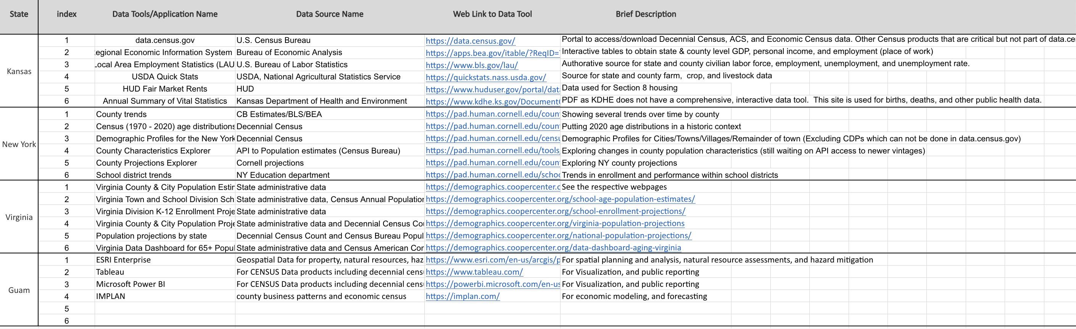
Snapshot: Collected FSCPE Responses
Method 4:Survey of the Federal-State Cooperative for Population Estimates (FSCPE) contacts
Notes:
Reached out to all 56 contacts on the Federal-State Cooperative for Population Estimates (FSCPE) website
Asked for top 6 priority data applications with their corresponding data sources, a brief description/objective, and related web links

Slide 17
Method 5: Exploration of search platforms and databases – examples
Search Platform
  elicit.org – Elicit is an online tool developed by the U.S. nonprofit Ought, a machine learning research lab.
Databases
  Policy Commons (accessed through the University of Virginia (UVA) library)
  Policy Index File (accessed through the UVA library)
  Policy Map
Websites
  Urban Institute
  Association of Public Data Users
  Council of State Governments
  National Association of Counties
  National Conference of State Legislatures
Notes:
Questions asked:
1. What are the data needs of U.S. state and local governments?
2. What can the Census do to help U.S. State Data Centers?
3. What data do U.S. local governments want?
4. How can the U.S. Census help State Data Centers?
5. What are the United States local government data needs?

Slide 18
Findings – Data Needs from platforms explored
Method 5: Exploration of search platforms and databases
  Exploring search platforms, databases, and websites about data needs provided some common themes across the examples below. These needs are:
  To provide required interim reports for federal grant programs;
  To track federally funded projects and to demonstrate impact;
  To proactively provide data and maps to meet local needs;
  To provide data for small areas;
  To inform strategies to support local and state populations, e.g., affordable housing strategies and
  To conduct impact analysis tailored to policy issues at local and state levels.
Notes:
3.5.1 Search Platform
elicit.org – Elicit is an online tool developed by the U.S. nonprofit Ought, a machine learning research lab. The following questions were used to queried.
1. What are the data needs of U.S. state and local governments?
2. What can the Census do to help U.S. State Data Centers?
3. What data do U.S. local governments want?
4. How can the U.S. Census help State Data Centers?
5. What are the United States local government data needs?
3.5.2 Databases
Various iterations of the above questions in Section 3.5.1 were used to search the following two databases that provide insights into many resources. Since we focused on SDCs, we spent limited time exploring data needs through these venues but provide them as another avenue for future research.
Policy Commons (accessed through the University of Virginia (UVA) library) – Policy Commons is a public policy database launched in November 2020. It contains documents from over 10,000 think tanks, nongovernmental organizations, and research centers. The database includes public policy academic and grey literature, for example, reports, policy literature, working papers, newsletters, government documents, speeches, white papers, urban plans, and preserves documents removed from the internet and defunct organizations.
Policy Index File (accessed through the UVA library) – The Policy File Index provides information from over 350 public policy think tanks, nongovernmental organizations, research institutes, university centers, advocacy groups, and other entities. Over 75 public policy topics are covered, from foreign to domestic.
3.5.3 Websites
Various iterations of the questions in Section 3.5.1 were used to search the following nonprofit websites.
Urban Institute – “The Urban Institute is a nonprofit research organization that provides data and evidence to help advance upward mobility and equity.” (Accessed 12/19/2023: https://www.urban.org/about/mission-and-values)
Association of Public Data Users – “The Association of Public Data Users (APDU) is a national network that links users, producers, and disseminators of government statistical data. APDU members share a vital concern about the collection, dissemination, preservation, and interpretation of public data.” (Accessed 12/19/2023: https://www.apdu.org/about-apdu)
Council of State Governments – The Council of State Governments is the nation’s largest nonpartisan organization serving all three branches of state elected and appointed officials. The mission of CSG is to champion excellence in state government.” (Accessed 12/19/2023: https://www.csg.org/about-us/)
National Association of Counties – “Through NACo, counties unite to advocate for county priorities in federal policymaking, promote exemplary county policies and practices, nurture leadership skills and expand knowledge networks, optimize county and taxpayer resources and cost savings, and enrich the public’s understanding of county government.” (Accessed 12/19/2023: https://www.naco.org/page/about-naco)
National Conference of State Legislatures – “NCSL provides objective, fact- and evidence-based (nonpartisan) research, technical assistance, skills training, and other resources to support the policymaking process.” (Accessed 12/19/2023: https://www.ncsl.org/our-work)

Slide 19
Limitation of Methods
Text analysis of state constitutions and amendments
  Topic modelling finds cluster of topics related to government and governance BUT no mention of state data needs
Review of SDC websites
  Substantial time investment in manual searches
  Subjectivity in classification
  Potential for excluding data
Survey of the Federal-State Cooperative for Population Estimates (FSCPE) contacts – there were limited responses
Notes:
One of the key challenges with the text analysis of state constitutions and amendments approach, was understanding context for accurate interpretation of the results. Using GENSIM and BERT, we found cluster of topics related to government and governance, without any mention of state data needs.
Due to the varied organizational structures of the SDCs, we opted against employing web scraping for a systematic SDC review and instead conducted a manual audit.
The primary drawback of the manual search lies in the substantial time investment.
It's important to acknowledge that our categorization of the six identified SDC categories—demographics, economy, education, health, housing, and diversity—is subjective and may differ from how the SDCs present their data. Different analysts could possibly infer different classifications from the data available in the SDCs.
While our manual search was systematic, there's a potential for excluding data related to the six categories or other relevant general information.
In the survey of the Federal-State Cooperative for Population Estimates (FSCPE) contacts, limited responses from members posed a limitation.
In summary, our chosen methods have certain limitations, including subjectivity in classification, time constraints in manual searches, and limited responses in surveys. These considerations are crucial for future efforts aiming to reproduce our approach and should be factored into the interpretation of results.

Slide 20
Conclusions
Significant variability in the types and presentation of data and data products in the SDCs
Data citation practices
  Most SDCs attribute their data to the U.S. Census Bureau without specifying the Census Bureau survey or other data product used
    Introduction of the citation feature in the tables on data.census.gov represents a positive development to facilitate adding this information to the SDC websites
Notes:
Substantial variations exist among states concerning the accessibility of data on the websites maintained by the leading and coordinating agencies of the SDCs.
The significant variability in the layout of SDCs across states posed a substantial challenge at the project's outset.
SDC’s data citation practices
More often than not, SDCs attribute their data to the U.S. Census Bureau without specifying the Census Bureau product or survey
Nearly all SDCs referenced their data sources; however, they did not include Digital Object Identifiers (DOIs) nor data citations.
The introduction of the citation feature within the tables on data.census.gov represents a positive development. This feature not only aids the SDCs but also enhances the ability of other researchers using Census Bureau data to furnish dependable citations.

Slide 21
Recommendations
Conduct a deeper dive into fewer states, starting with our list of early adopters, including talking to SDC staff, data users who use the SDCs, and others (Colorado, New Mexico, Kansas, and New York)
Achieve some level of consistency in the presentation of the data, starting with population trends and projections. Start with a few states, learn, and expand to other states.
Housekeeping
Conduct regular reviews of SDC lead and coordinating agencies and update links, as needed, on the Census Bureau’s website
Provide additional clarity on the Census Bureau citations policy webpage and send regular updates on this policy to SDCs lead and coordinating agencies
Census Bureau suggests adherence to the Office of Management and Budget (OMB) standards related to race and ethnicity categories
in data reporting by its SDC partners
Notes:
In this study, we were ambitious in undertaking multiple approaches to assess state and local data needs. As a next step, we recommend a deeper dive into fewer states, starting with our list of early adopters (Colorado, New Mexico, Kansas, and New York) and proactive data developers (Utah and North Carolina). A deeper dive could include a more detailed review of the SDC websites, interviews, focus groups with the SDC and Coordinating Agency employees and data users, and other methods to provide a richer overview of SDCs.
While recognizing the challenges posed by state variations in resources and type of SDC, the Census Bureau could help achieve some level of consistency in the presentation of the data, starting with population trends and projections. Over time, this would help reduce data access disparities across states.
Housekeeping:
Conduct regular updates to SDC and Coordinating Agency links on the Census Bureau’s website with SDCs. This could be a monthly or quarterly call to SDCs and Coordinating Agencies to check the links and provide updates to the Census Bureau. This collaborative effort would enhance the accuracy and accessibility of SDC-related information, benefiting researchers and users seeking reliable data. Exhibit A2 in the appendix provides the most current weblinks for few SDCs found in our review.
Provide additional clarity on the Census Bureau citations policy webpage and send regular updates on this policy to SDCs and Coordinating Agencies.
The 2020 Census showed increased racial and ethnic diversity within the U.S. population compared to the previous decade (Menchaca et al. 2023). In light of this, we recommend that the Census Bureau encourage the State Data Centers (SDCs) to enhance the accessibility and widespread reporting of diversity information concerning statewide race and ethnicity distribution. The Bureau could also advocate for adherence to the Office of Management and Budget (OMB) standards related to race and ethnicity categories in data reporting by its SDC partners.

Slide 22
Thank You!

